Slide 1

Course : ENTR6003 – Entrepreneurship 1
Year : September 2017
“Assessing Our
Value Proposition (S)”
Session 10
F2F

Slide 2
LO 2: Describe the Value Propositon of the Created Business Idea LO 3: Assess the Value Proposition of the Created Business Idea
Learning Objectives

Slide 3
Sub Topics
10 Characteristics of Great Value Propositions
Assessing the Value Proposition
Compare Our Value Proposition with Competitor

Slide 4
10 Characteristics of Great Value Propositions

Slide 5

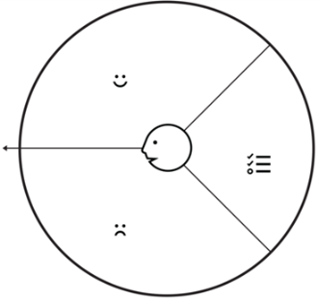



10 Characters of
The Great Value Propositions
Focus on the jobs, pains, and gains that matter most to the customers
Embedded in
great business models
Target few jobs, pains, and gains, but do so extremely well
Go beyond functional jobs and address the emotional and social jobs
Focus on unsatisfied jobs, unresolved pains, and unrealized gains

Slide 6





10 Characters of
The Great Value Propositions
Focus on jobs, pains, and gains that a lot of people have or that some will pay a lot of money for
Align with customers measure success
Differentiate from competition on jobs, pains, and gains that customer care about
Outperform competition substantially on at least one dimension
Very unique, difficult to copy

Slide 7
Assessing the Value Proposition

Slide 8
Assessing
the Value Proposition
ASK THESE QUESTIONS:
Is it embedded to a great business model?
Does it focus on the most important jobs, most extreme pains, and most essential gains?
Does it focus on unsatisfied jobs, unresolved pains and unrealized gains?
Does it concentrate on only few pain reliever and gain creators but does it extremely well?
Does it address functional, emotional, and social jobs all together?
Does it align with how cutomers measure success?
Does it focus on jobs, pains, or gains that a large number of customers have or for which a small number are willing to pay a lot of money?
Does it differentiate from competition i a meaningful way?
Does it outperform competition substantially on at least one dimension?
Is it difficult to copy?

Slide 9
Compare Our Value Proposition with Competitor

Slide 10
Why Should be Compared?
Value Propositions are the key indicators of a product’s value potential
The business should be focused on sustainable value
Comparing the Value Proposition would allow us to evolve, renew our value proposition into the newest and unique VP.
Markets might have copied the earlier value propositions. By comparing our VP with others, we would be able to know what kinds of VP that others are currently using, and how does it impact us.
If the impacts are considerably negative, it might be a good time to start develop new value proposition, in order to maintain the position of the business in the market.

Slide 11
References
Alexander O, Yves P, Greg B, and Alan S (2014), Value Proposition Design. John Wiley & Co, New Jersey. ISBN: 978-1-118-96805
https://www.hiconversion.com/blog/comparing-value-propositions-testing-personalization-and-e-revenue-performance-management-solutions/

